Slide 1

Library management system
Danish Khan 201P027
Utsav Kuntalwad 201P049
Mayur Kyatham 201P013

Slide 2
Description of project
Now a day, through the advancement of modern technology, there are a lot of fast and reliable alternatives for research. However, library still pays a vital role on the students and researcher’s life. Library is still considered the most accurate place for information. Undeniably, people especially those who are not having internet connections, and even electricity, rely solely on books. Libraries also supply information not found on World Wide Web. Library still remain the cheapest and the most accessible place for research. Gathering of information still plays a very important role when it comes to gathering of information.
This system is being conceptualized in order for the librarian to access all the books that was barrowed by the student in the school. And we also know that now days in this generation we are used to live with technology and we implement this system.

Slide 3
Overview of the project
Objective
Library Management System in which we can perform all CRUD operations, in addition to advanced search, book issuing, Serialization, and Deserialization
Project context
Management systems mostly use software across all schools and colleges to keep record of data. One such system is the Library Management System, which is used to keep records of books present in a library.
These Systems comprise of information regarding Books, where we can perform all the operations that are required in an actual system such as CRUD operation, advanced search, book issuing, and also to store the information within files using the process known as Serialization.
Project stages
Implement searching for books based on their name or authors name
Emulate admin login session via the command line
Implement the functionality to issue a book for a user
Implement serialization and deserialization to store the data in encrypted format in files
Create a blueprint to store Book details

Slide 4
Task 1 : Getting started
Project is going to be a command line application in Java. Like most typical command line applications, it'll contain a switch case that will display a set of options to the user to perform the actions and make necessary queries.
We'll start off by creating an object for storing details of books and also adding some code to our public static void main(String[] args).
Created a class Book, for addition of book details.
Added required fields such as bookId, bookName, writerName, price and quantity.
In our main code, we used Java Collections to efficiently store the accepted book details
Here we used concepts such as :
Classed and Objects
Collection in java
ArrayList in java

Slide 5
Task 2 : Addition and Deletion of book details
Here we'll be adding the functionality to add/delete book details
Here we should be able to accept details for a specific book and store the same in an object of type Book.
Every time we add the details of a new book in our already present collection (preferably ArrayList), generate a unique bookId for the same.
Accept a query for deleting book details and perform the same. We should check whether the book details requested to be deleted are present or not.
Here we should have an attribute called quantity for each object of type Book. This attribute can come in handy when we want to reduce the quantity of a specific book.
We should be able to check whether the number to be subtracted is actually lesser or equal to the already present quantity or not.

Slide 6
Task 3 : Searching
We should be able to search for a particular book based on its name or the writer's name
Search for book details by bookName. If found, display the details or display Book Absent.
Search for book details by writerName. If found, display the details or display Writer Absent.
Add the ability to search for a subsequence of bookName or writerName.
The search functionality should not be case sensitive.
The concept used here is : Searching characters and substring in a String

Slide 7
Task 4 : Issue Book
In this task, we'll be implementing the functionality for users to issue a book. Only admins will be allowed to issue books to users
In order to issue a book, we'll need a user. For the same, create a User entity with fields userId (should be auto-generated), password, role (Admin/User).
Create a class IssueBook having attributes bookId and userId. The objects of this class will basically be created whenever a user issues a book.
This should accept various user details from the command line.
In order to issue a book for a User, emulate a login session for Admin in the command line. On issuing, add the details as an object of type IssueBook to an ArrayList of the same type.

Slide 8
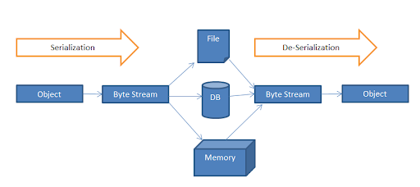
Task 5 : Serialization and Deserialization using Files
Now our main program should run fine. It should be able to add and remove book details. Add users and admins and enable admin login sessions to issue books for users. But if we stop our program execution, all the data gets deleted. That means that we'll need a way to store our data so that we can access and manipulate it at a later time.
Create three files: userDetails.txt, bookDetails.txt and issueBook.txt.
All the data should be stored in these files in an encrypted format.
Utilize the concept of serialization to store the data to the files.
Utilize the concept of deserialization to access the data from the files.
The concept we used in this task is :
Serialization and Deserialization

Slide 9
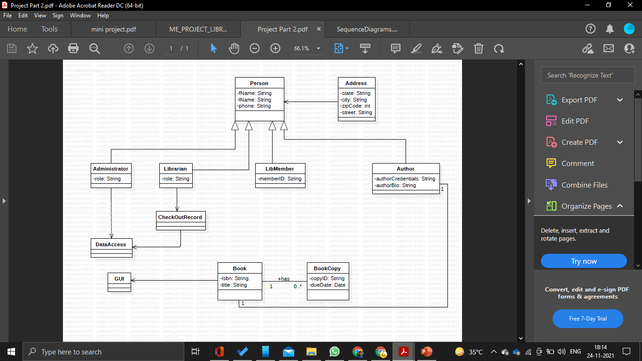
Task 6:Implementing GUI framework using JFrame of applets library
JApplet — a class that enables applets to use Swing components.
JApplet is a subclass of java.applet.Applet, which is covered in the Java Applets trail.
Japplet is a top level swing container each swing applet has a root pane .The most noticeable effects of the root panes presence are support for adding a menu bar and the need to use a content pane
Swing components should be created queried and manipulated on the event dispatching thread but browsers don’t involve applet “milestone” methods from that thread.

Slide 10
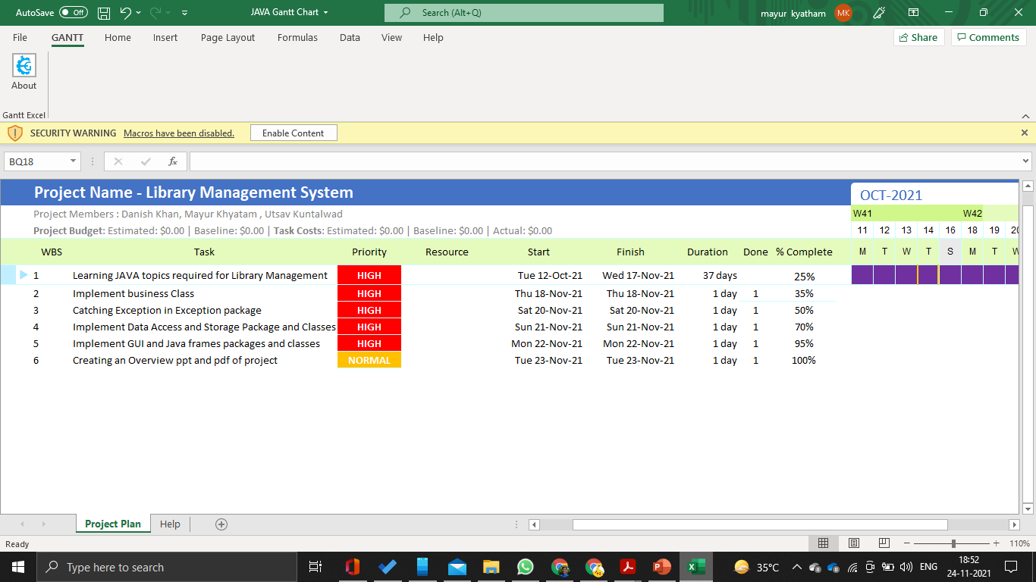
Gantt Chart

Slide 11
Conclusion
A Library Management System Project in Java is one of the various systems developed that has numerous functionalities that meet the current requirements of the present-day library system. To enhance it, we can add features like RFID, SMS to remind users of the return date, and others. Java has many features that can be explored to create such wonderful programs.

